Slide 1
The Ganges River

Slide 2
The Ganges
Most well-known of the South Asian rivers
Flows more than 1,500 miles; from its source in a Himalayan glacier to the Bay of Bengal

Slide 3
The Ganges
It is both an important water source as well as a sacred river
In the Hindu faith it is known as the home of the Goddess Ganga
Throughout India it is known as the Gangamai, which means “Mother Ganges”
Hindus believe that the river brings life to its people and it also has healing powers

Slide 4
The Ganges
Varanasi: A city on the banks of the Ganges
One of the most sacred sites on the river
Every day at sunrise, thousands of people gather in Varanasi in the waters of the Ganges for purification and prayer

Slide 6
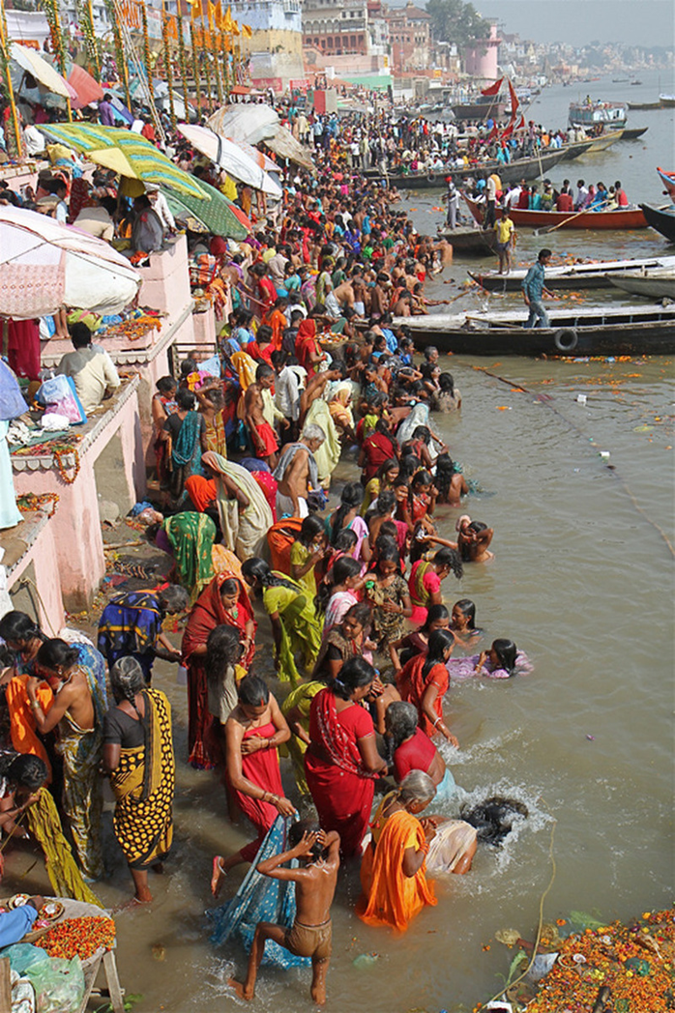

Slide 8
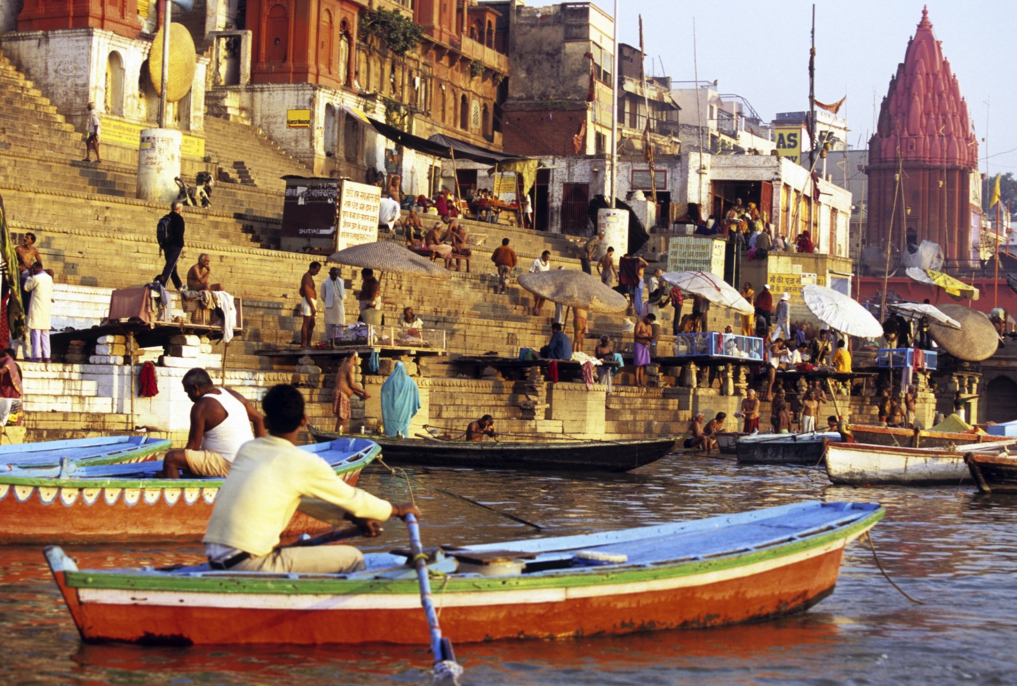

Slide 9
Problems With Pollution
After hundreds of years of human use, the Ganges has become extremely polluted
Millions of gallons of raw sewage and industrial waste water flow into the river every day
The water is poisoned with deadly chemicals and harmful bacteria

Slide 10
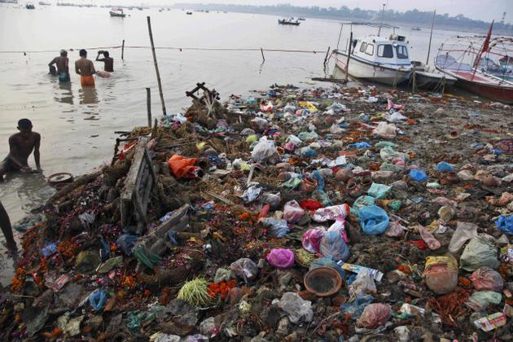

Slide 12
Problems With Pollution
Attempts have been made to clean up the river, but progress has been extremely slow
With so many people depending on the river on a daily basis, it has been an extremely difficult task
Many Hindus believe the river is “too holy” to be polluted
If there is a problem with pollution they believe “Mother Ganges” will fix it

